Slide 1

Improving Cash Flow
12/5/2025
Kolos Nagy

Slide 2
Improving Cash Flow by Addressing Overdue Invoices
Opportunity: The organization’s cash flow and financial stability can be significantly enhanced through the aggressive tackling and reducing the overdue invoices as the main opportunity.
Current Problem:By analyzing the data, it becomes clear that the main source of revenue is the projects invoiced. It is expected that some of these invoices will become overdue, which will have a direct effect on working capital and will cause a slowdown in business operations.
Solution:Implement a Targeted Accounts Receivable (AR) Optimization Program focusing on: customers, payments, and invoices, and eliminate all overdue invoices.

Slide 3
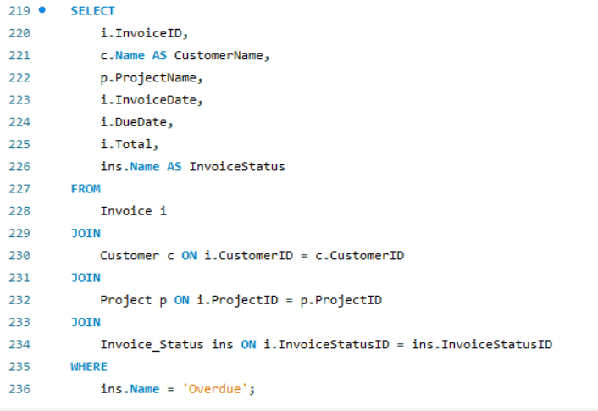
Performing an Exploratory Data Analysis (EDA)
1. Step is to identify the scale of the problem, in this case, the overdue invoices.
First goal is to find the total amount of invoices that have an ‚Overdue’ status.
After running the query in the picture, we can identify the overdue invoices.
EDA Finding 1: We have one invoice currently Overdue (Harbor Retail 204), amounting to $1,370.00 of frozen capital.

Slide 4
Why This Matters
Overdue invoices directly restrict immediate cash availibilty​
If trend continues it can lead to problems such as​
  Paying suppliers​
  Covering operations costs​
  Funding for future projects​
Addressing overdue balances early can help maintain even cash flow and prevent us from failing behind and causing issues down the line​

Slide 5
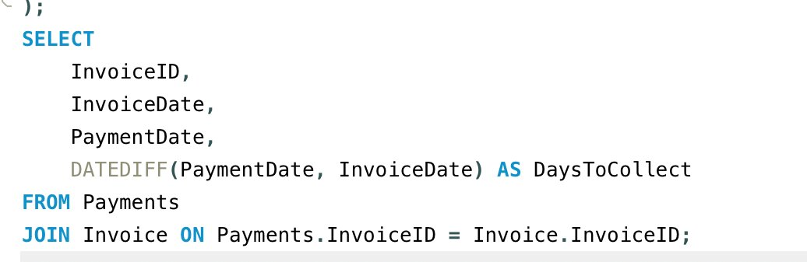
EDA Insight
This allows us to see if
  Payments are running on time or late
  Which clients take the longest and shortest to pay
  Is the payment overdue an anomaly or coincidence

Slide 6
Indicators to Track
Metric | Meaning | Why It Matters
Days to Collect (DSO) | Avg time to receive payment | Longer = slower cash flow
% of Invoices Overdue | Portion of receivables unpaid past terms | High % = weak collections process
Aging Brackets (0-30)/(31-60)/(60+) | How long invoices remain unpaid | Shows risk levels & trends
Outstanding Receivables | Total cash not yet collected | Direct impact on liquidity

Slide 7
Key Insights
Overdue invoices reduce working capital and slow operations.
A small number of overdue invoices can highlight larger AR Management issues
Payment terms and method likely influence the speed of cash inflow highlighting the need for strategic management of accounts receivable.
Opportunity: Implement a Targeted Accounts Receivable (AR) Optimization Program focusing on customers, payments, and invoices

Slide 8
Recommended Solution and Expected Impact
AR Optimization Program
Customer Management: Automated reminders and early payment incentives
Invoice Process: Flag approaching due dates; partial upfront payment
Payment Policies: Encourage faster payment methods; adjust terms for higher risk customers
Expected Impact
Reduce overdue invoices and free working capital.
Improve project execution and budgeting.
Lower financial risk and administrative effort.

Slide 9
Next Steps
Implementing the AR Optimization Program stabilizes cash flow and reduces financial risk.
Proactive management of invoices ensures operational continuity and supports project funding.
Data-driven decisions strengthen financial performance and organizational efficiency.
Next Steps: monitor overdue invoices, refine AR processes, and track improvements over time.

